Slide 1
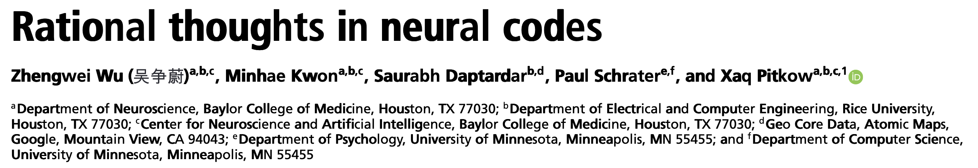

Xaq Pitkow @ CMU, Neuroscience Institute, with affliation to ML Department
lab site: https://xaqlab.com/
presented by 陆杨帆，张博涛

Slide 2
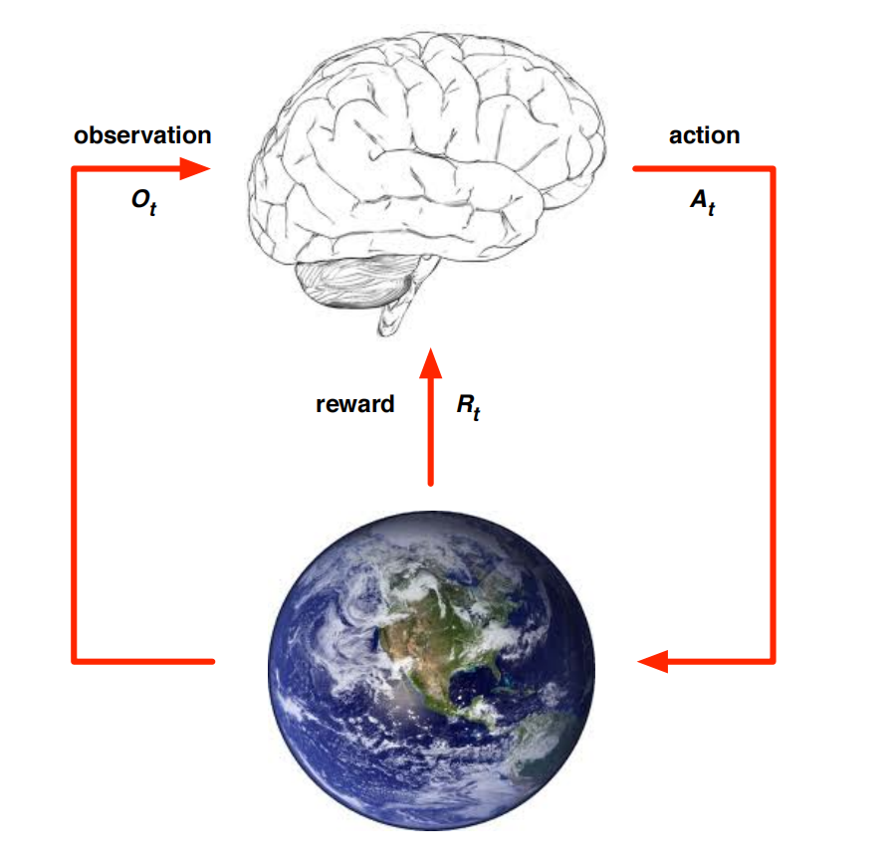

Reinforcement Learning
Given: reward(, state)
What is the optimal action?

Slide 3
Inverse Reinforcement Learning
Given: Action trajectory of an agent(mostly, an expert)
What is the reward(function that the agent is trying to maximize)?
Notes:
a rough understanding

Slide 4
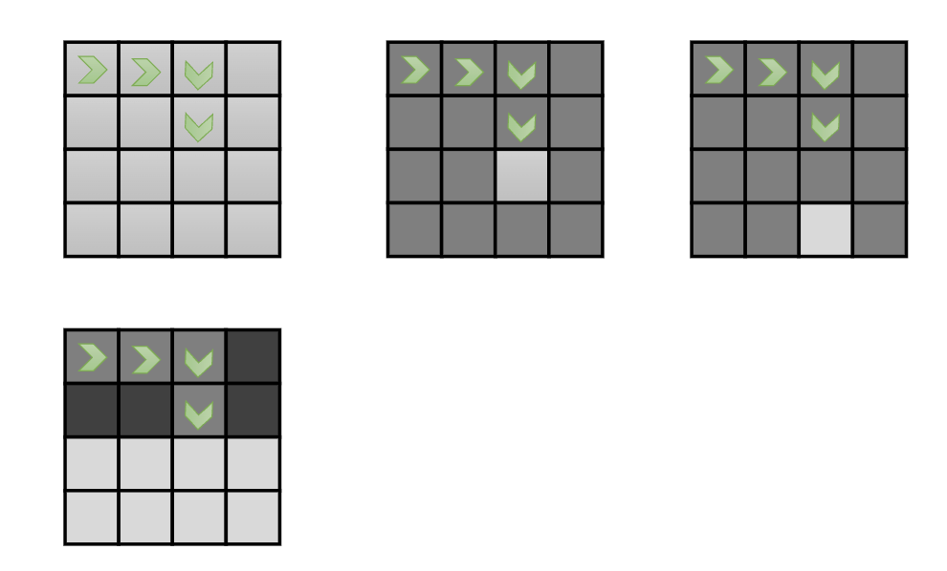
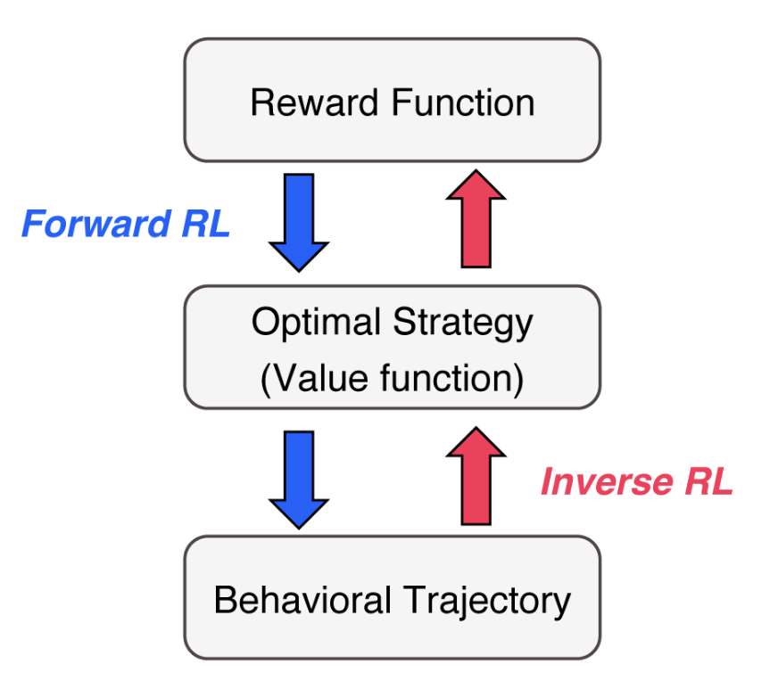
Inverse Reinforcement Learning
I saw him walking this way, what is his intention?
i.e. What is the reward at each state(-action) that makes him act like this?

Slide 5
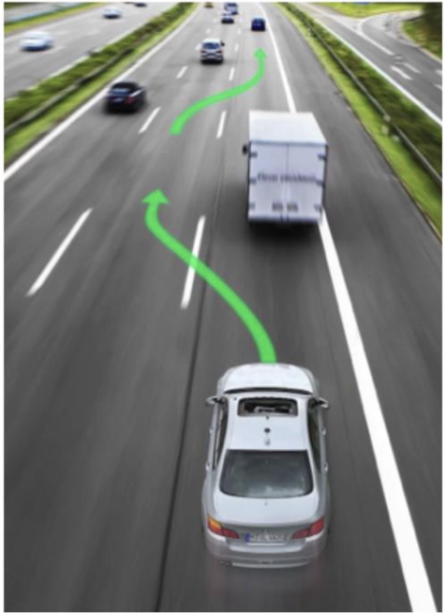
Inverse Reinforcement Learning
maintaining safe following distance?
keeping away from the curb?
staying far from any pedestrians?
maintaining a reasonable speed?
a slight preference for driving in the middle lane?
not changing lanes too often?
......
reward function is too complicated to hand-tune ☹

Slide 6
Inverse Reinforcement Learning
apprenticeship learning
but we can see what an expert does ☺︎
(and thus infer the reward function that give rise to
a good policy)
reward function is too complicated to hand-tune

Slide 7
Inverse Reinforcement Learning
Formal Definition:
Given
1) measurements of an agent’s behaviour over time, in a variety of circumstances,
2) measurements of the sensory inputs to that agent;
3) a model of the physical environment (including the agent’s body).
Determine the reward function that the agent is optimizing.
(Stuart Russell, 1998)

Slide 8
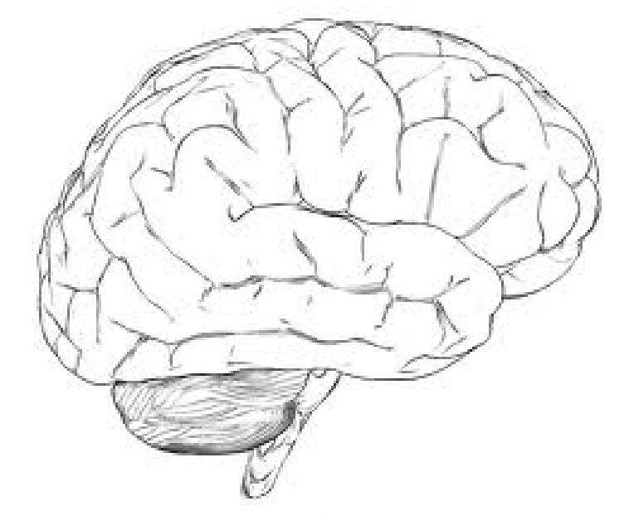



sensory
motor
thoughts

Slide 9
Inverse Rational Control
sensory
motor
We see what the agent observes and how he acts
Then we try to infer:
What’s the agent’s mental model?
What’s his belief of the world, e.g. transition prob, reward..

Slide 10
Inverse Rational Control
What if the agent is wrong... but
rational: doing wrong things for
the right reasons

Slide 11
Inverse Rational Control
What if the agent is wrong... but
rational: doing wrong things for
the right reasons
The agent’s belief about the world is wrong,
but it acts optimally according to the belief
(giving rise to suboptimal behavior)

Slide 12
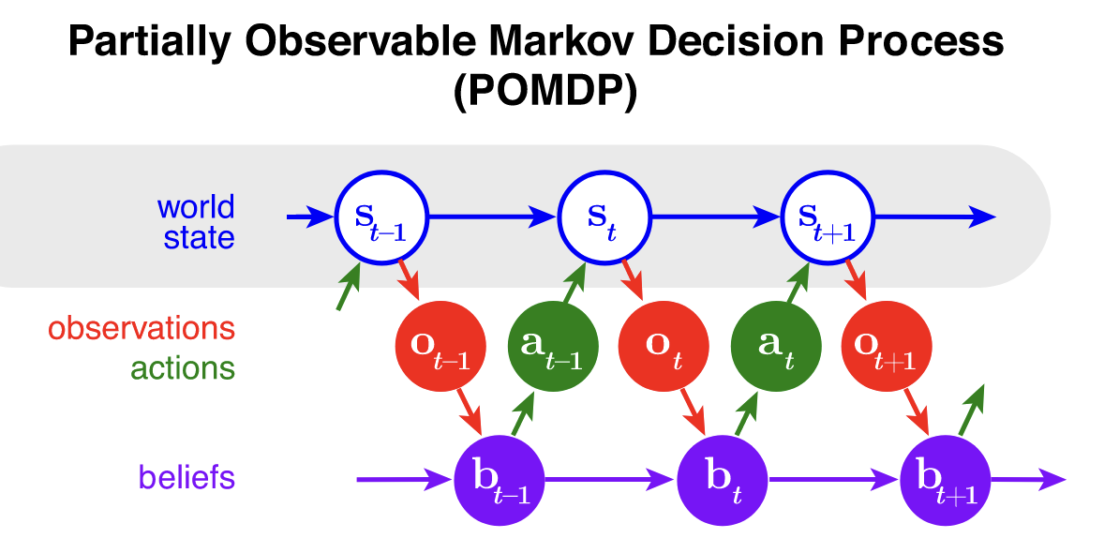
Modelling Behavior as Rational
MDP: agent knows the real state
POMDP: agent has to infer the true state from observations
(and actions)

Slide 13
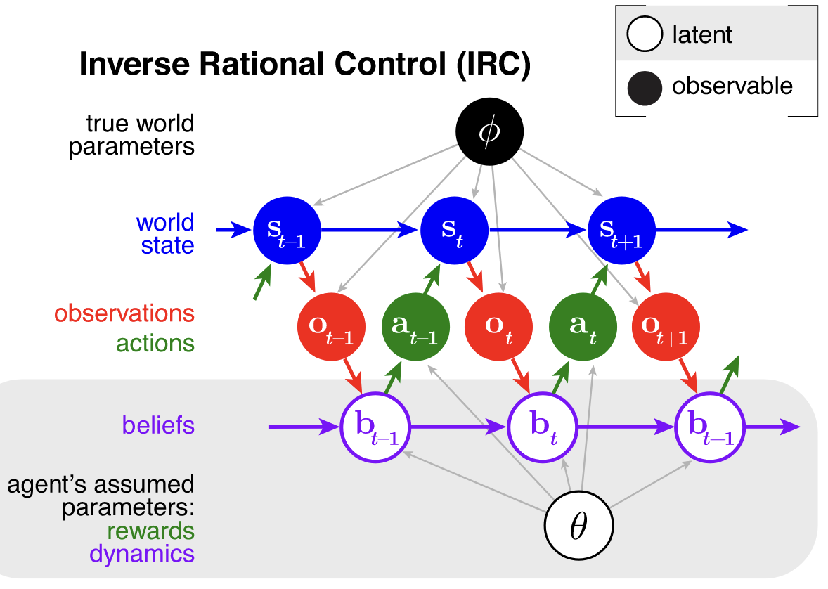
Modelling Behavior as Rational
to the experimenter
Assumptions:
1. maximize total utility
2. stationary policy, no learning

Slide 14
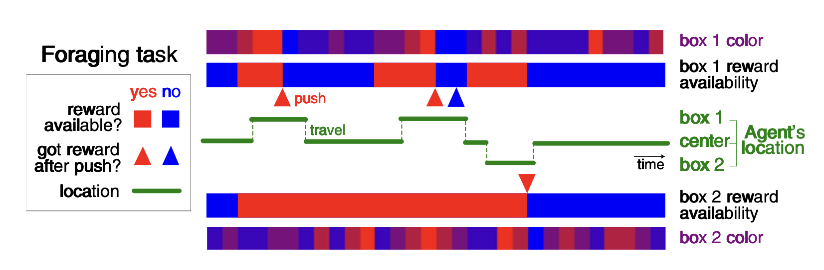
Modelling Behavior as Rational
agent’s parameters:
appearance rate(box1, 2), disappearance rate(box1, 2)
utility:
grooming reward
travel cost
push button cost
color parameters(box1, 2)
(color drawn from a binomial)
(useful when you’re right at the box)
(reward availability as a telegraph process)
(these parameters are very useful when you’re far away from the box)
Notes:
after button pushing, the

Slide 15
Maths behind modelling

Slide 16
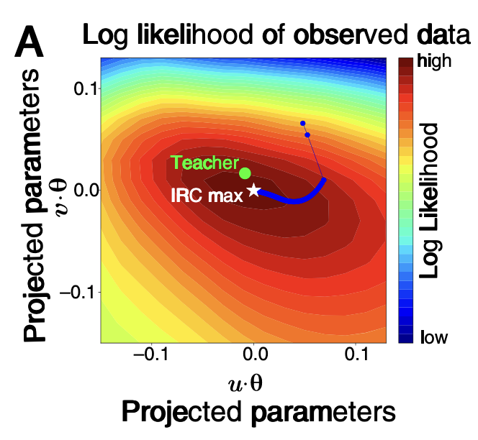
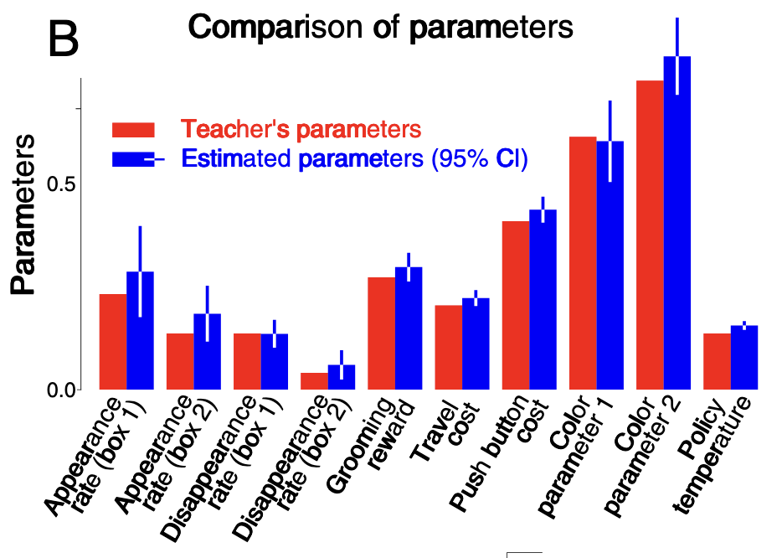
Modelling Behavior as Rational

Slide 17
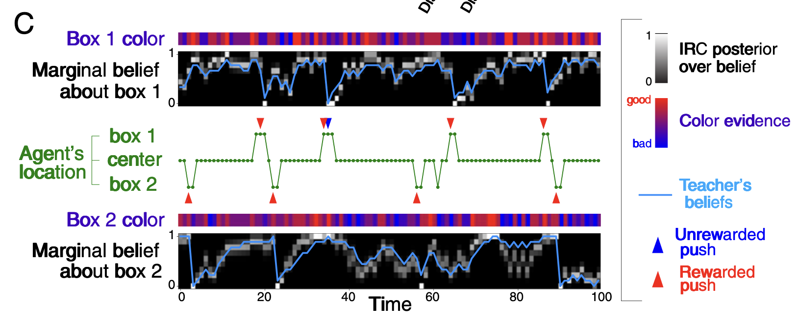
Modelling Behavior as Rational

Slide 18
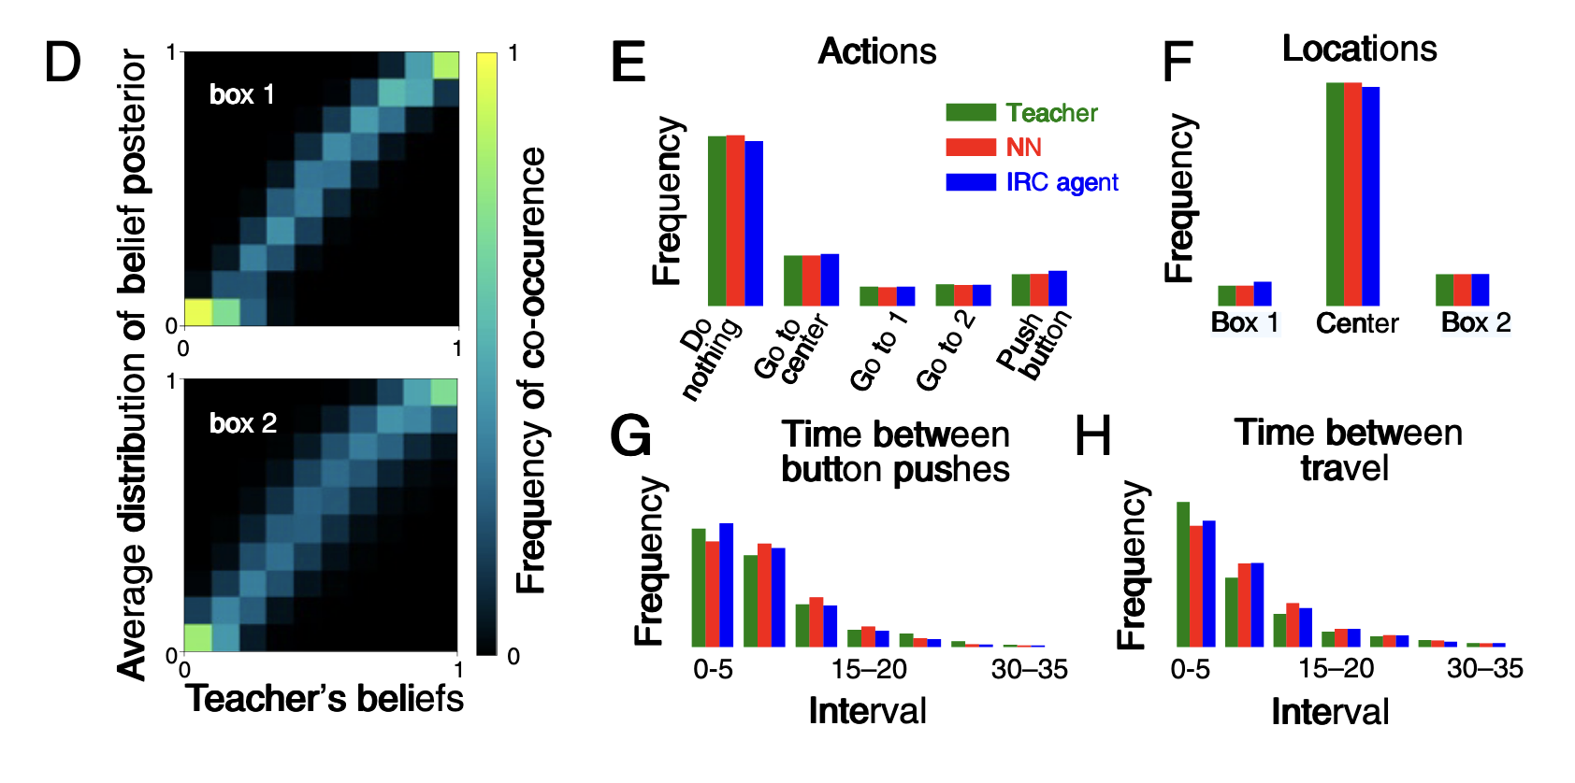
Modelling Behavior as Rational

Slide 19
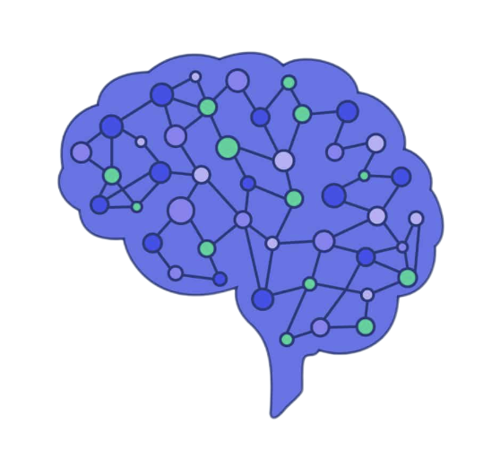

Modelling Behavior as Rational
input NN with slightly different parameters from the actual POMDP
(suboptimality)
train
minimize
(policy)
IRC
NN’s POMDP (belief)
teacher POMDP
Neural Network model

Slide 20
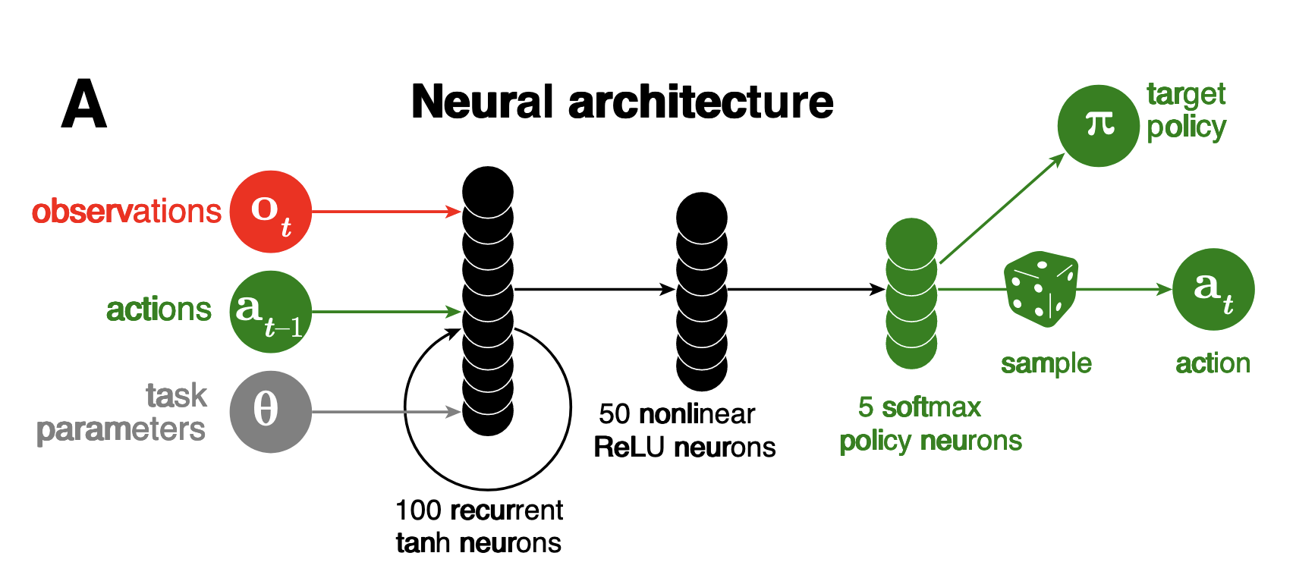
Modelling Behavior as Rational

Slide 21
Neural Coding
recoding
encoding
decoding
temporal dynamics of the
neural populations
Notes:
Encoding: How do neurons respond to stimuli, Recoding: How do neurons transform information, Decoding: how do neurons drive behavior

Slide 22
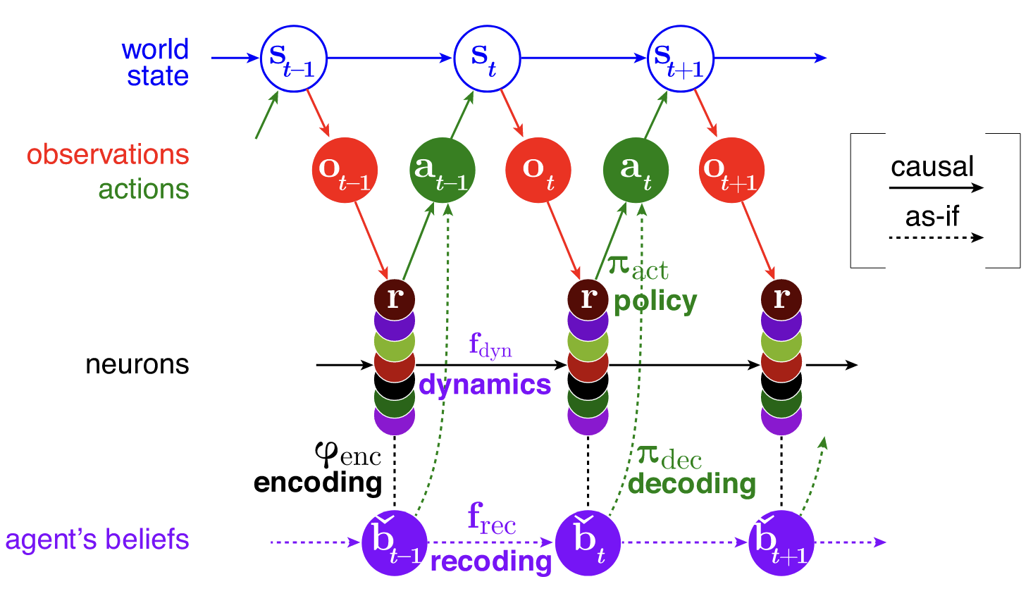
Neural Coding: neural implementation of POMDP

Slide 23
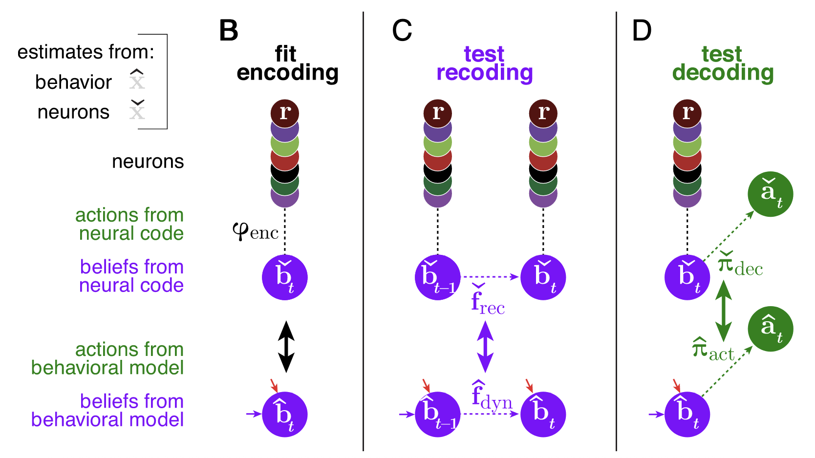
Neural Coding of rational thoughts

Slide 24
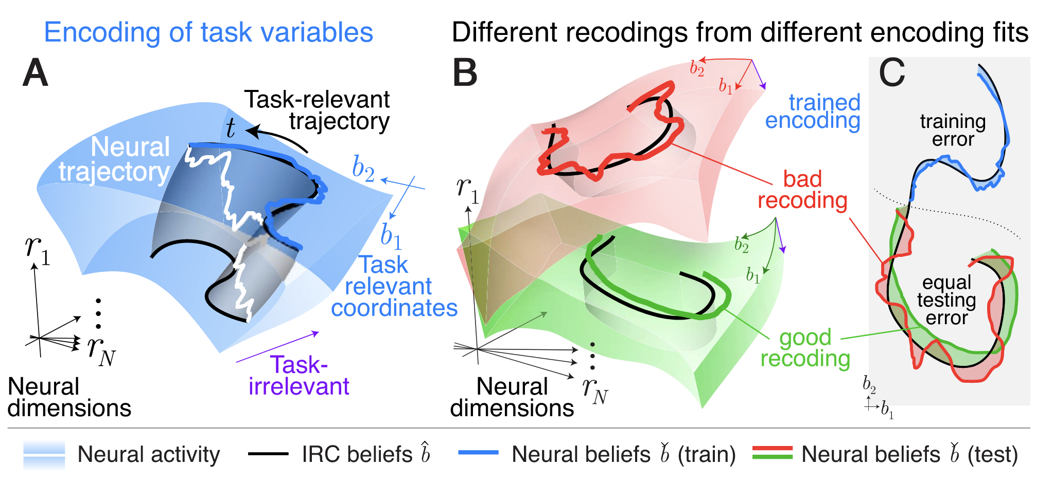
Neural Coding

Slide 25
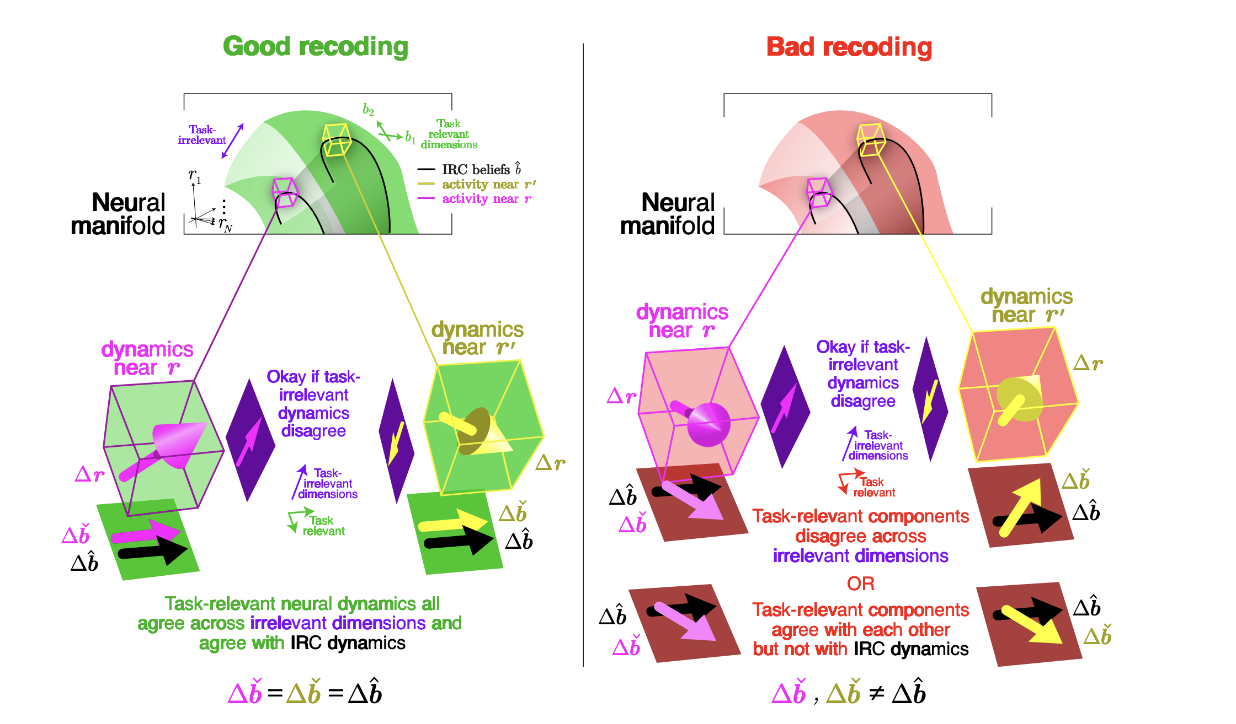

Slide 26
Neural Coding

Slide 27
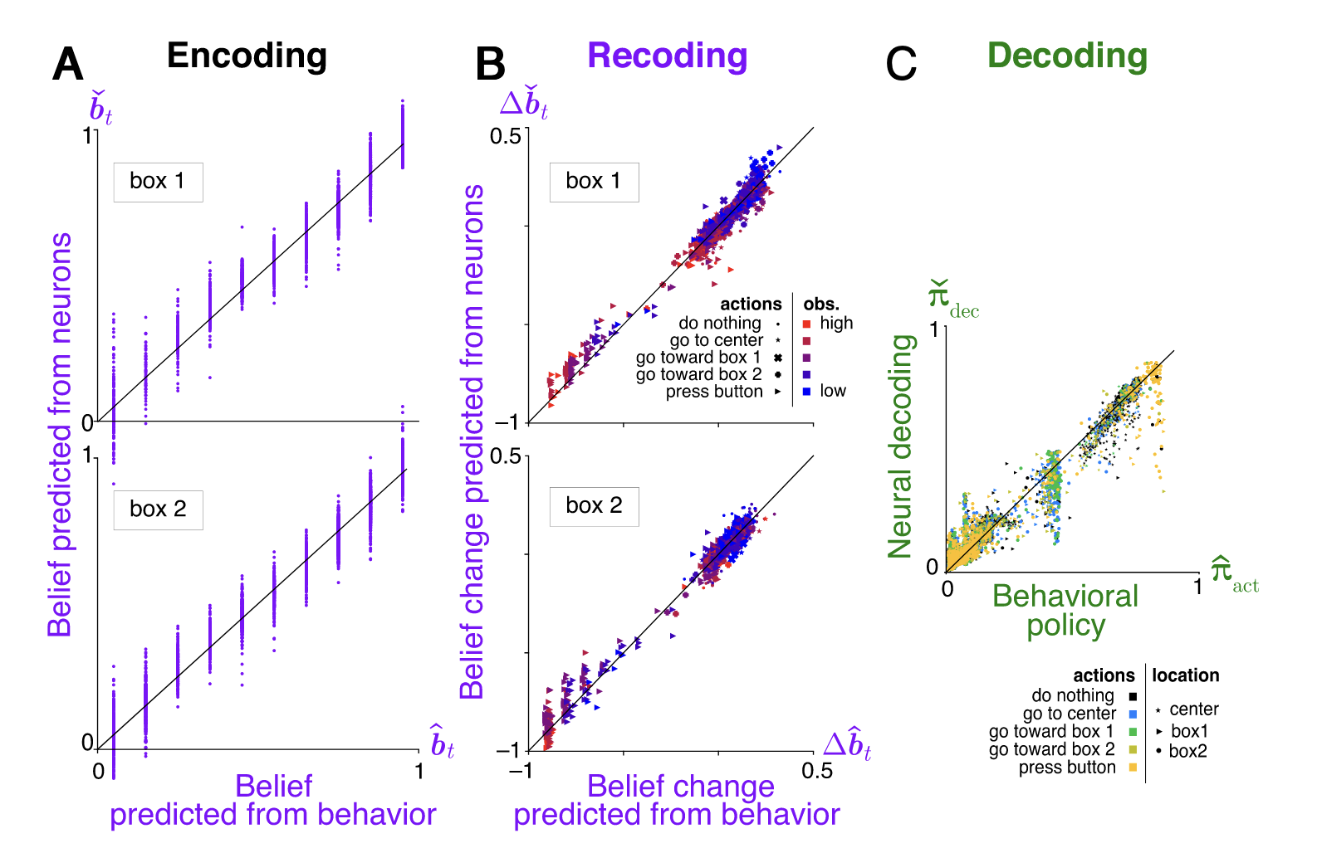
Neural Coding

Slide 28
Problems

Slide 29
Problems

Slide 30
THE END
unless there’s still time left
Notes:
tribute to Hinton!

Slide 31
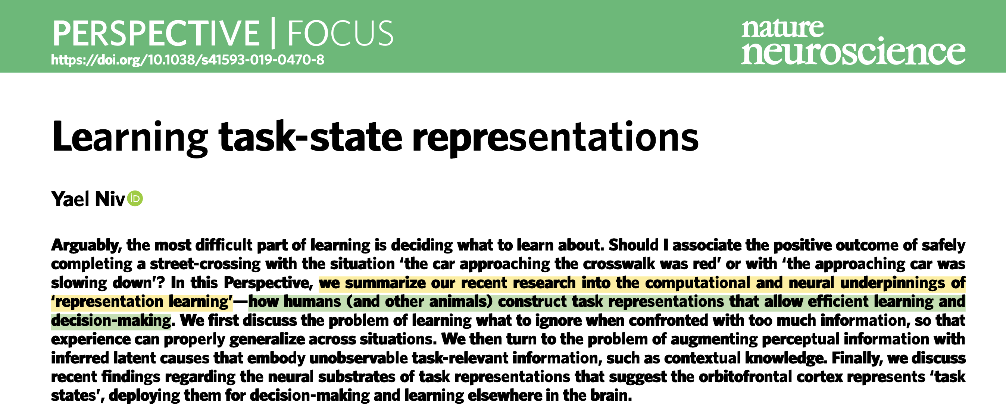
(?)Representation learning is the bridge from planning to problem solving

Slide 32
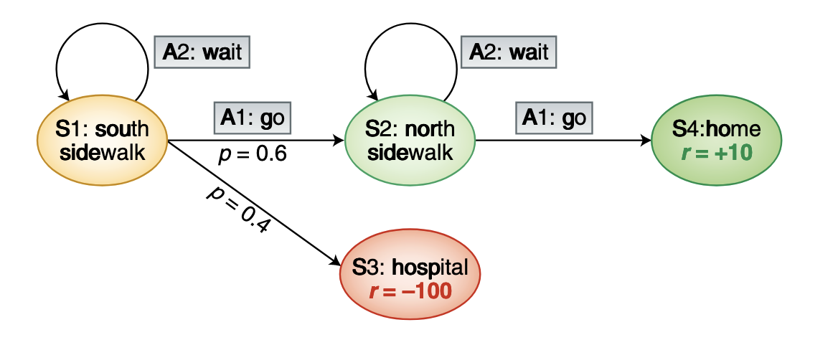
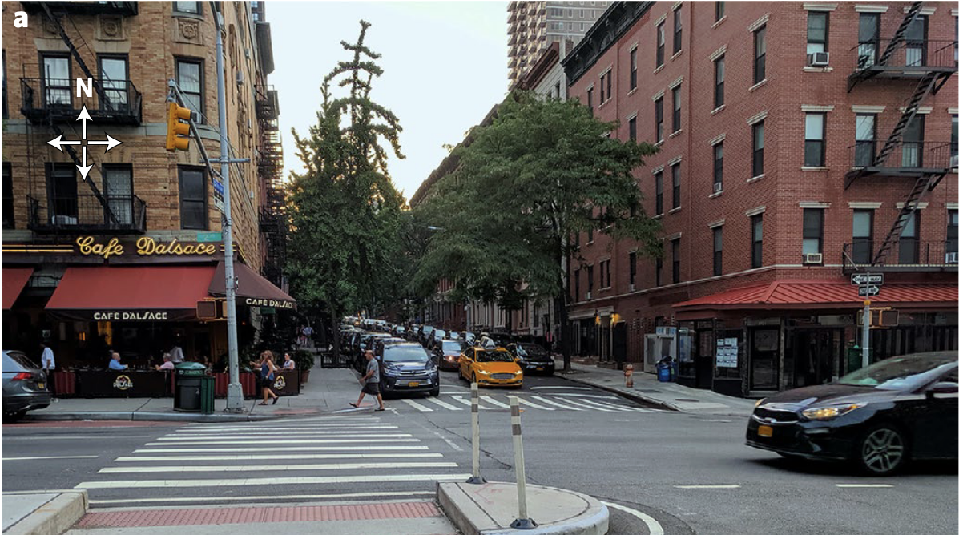
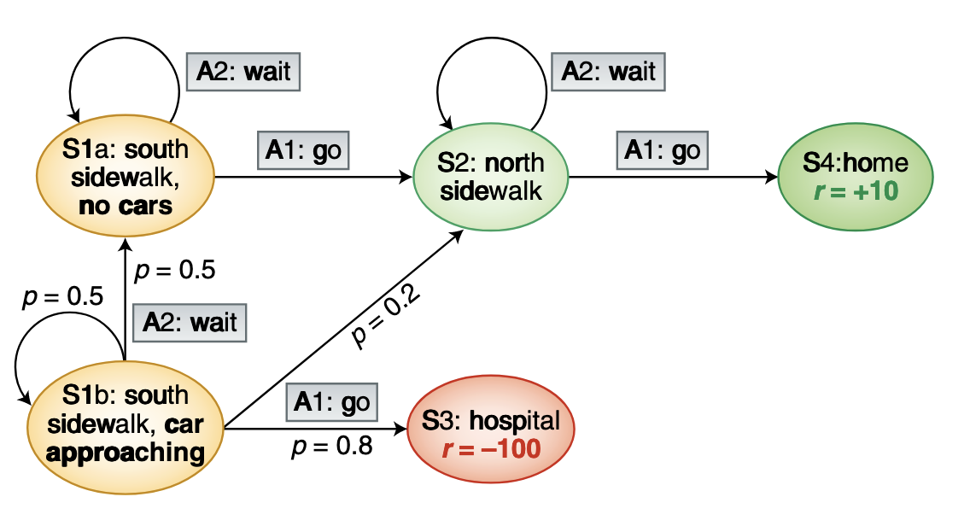

Slide 33
Problems in Mathematics
10 people A1-A10 attend a meeting, some of them shake hands with each other.
After the meeting, they report how many people they’ve shaked hands with:
respectively 2, 5, 6, 3, 10, 5, 7, 1, 4, 8.
Is it possible?

Slide 34
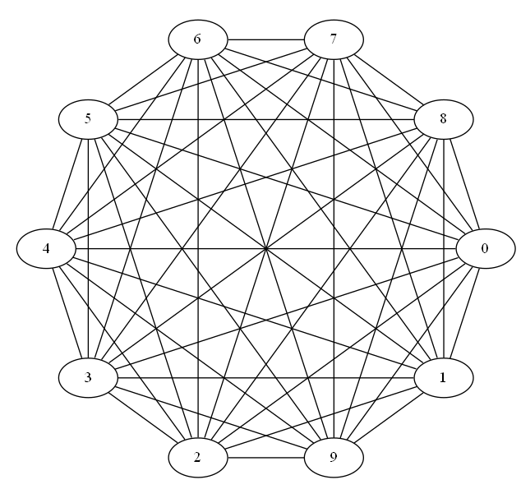
Problems in Mathematics
10 people A1-A10 attend a meeting, some of them shake hands with each other.
After the meeting, they report how many people they’ve shaked hands with:
respectively 2, 5, 6, 3, 10, 5, 7, 1, 4, 8.
If you try to do a tree search on the graph, tremendous computation...

Slide 35
Problems in Mathematics
10 people A1-A10 attend a meeting, some of them shake hands with each other.
After the meeting, they report how many people they’ve shaked hands with:
respectively 2, 5, 6, 3, 10, 5, 7, 1, 4, 8.
If you try to do a tree search on the graph, tremendous computation...
...but if you find an efficient representation of the task:
Is the sum of the degrees even?
2+5+...+8 = odd, so someone’s lying!

Slide 36
tasks do not have unique state representations
the brain solves seemingly complex tasks by learning efficient, low-dimensional representations that simplify these tasks
efficient representations are task-specific
how living agents know what to represent in order to use neural RL to solve tasks?

Slide 37
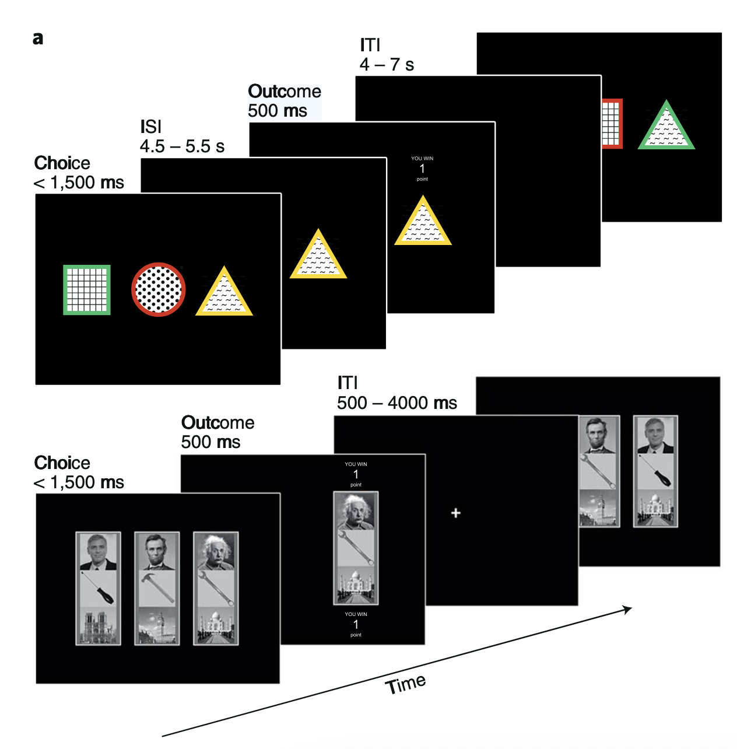
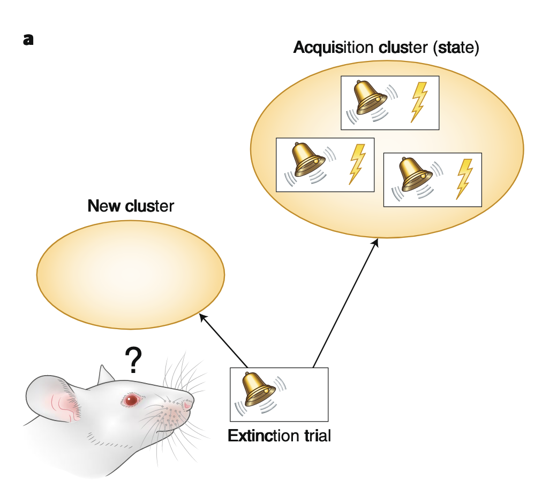
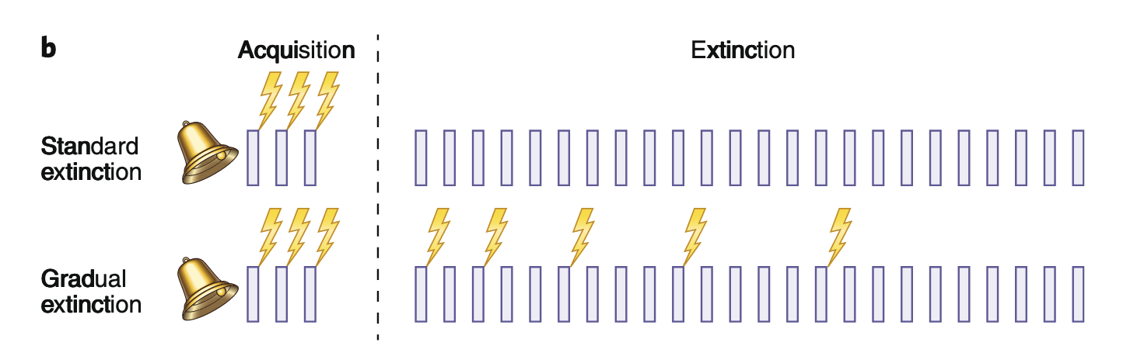
Attention
Similarity clustering of states

Slide 38
Can we devise complex tasks where representation (learning) really is the game changer?

Slide 39
THE END
Notes:
tribute to Hinton!

